Slide 1
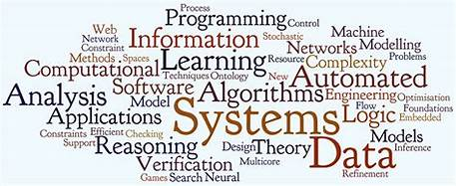





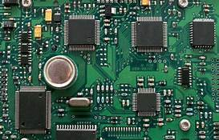


Project Title: Mass Monitoring Heart Rate System Ng Wei Ann

Slide 2
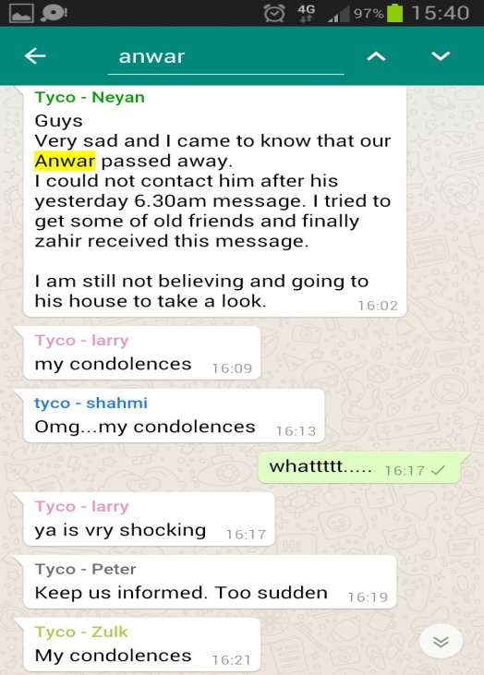
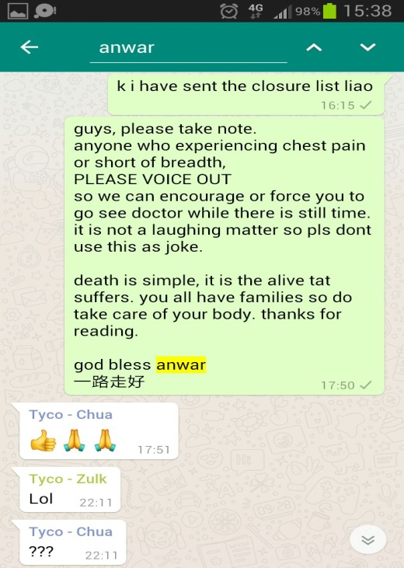
Introduction

Slide 3
Objective
method of notifying
simultaneously monitor multiple users' heart

Slide 4
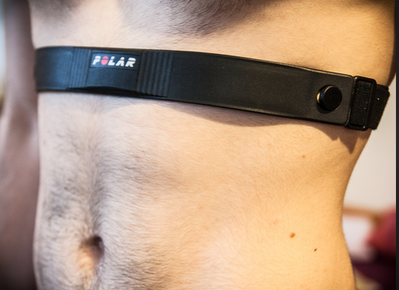
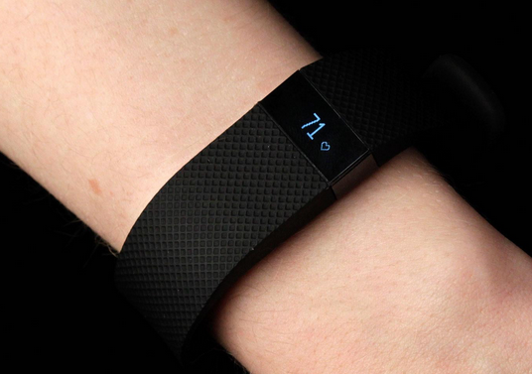
Types of Heart Rate Monitors

Slide 5
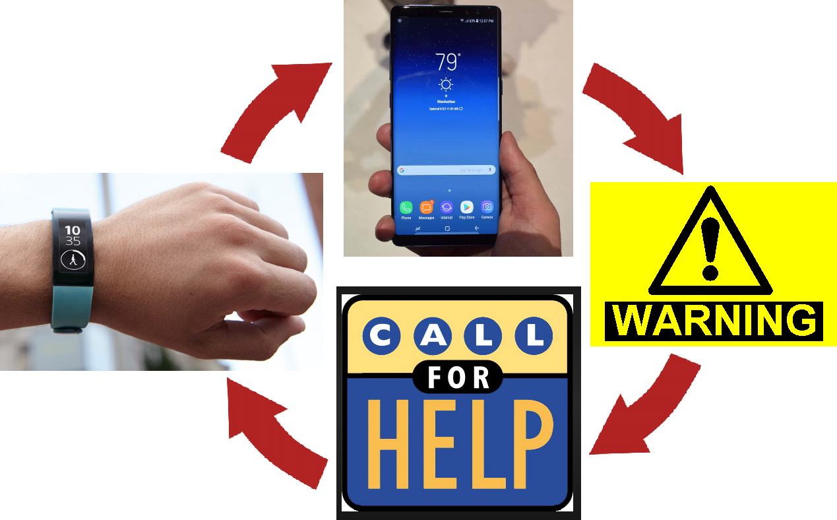
Idea 01

Slide 6
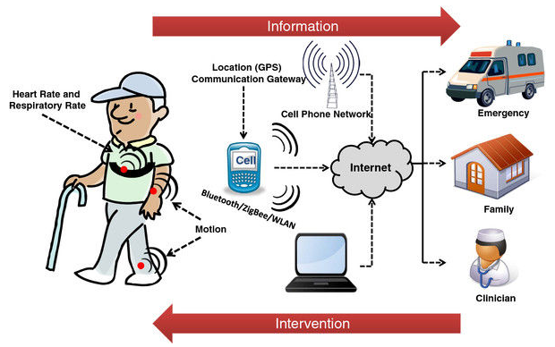
Idea 02

Slide 7
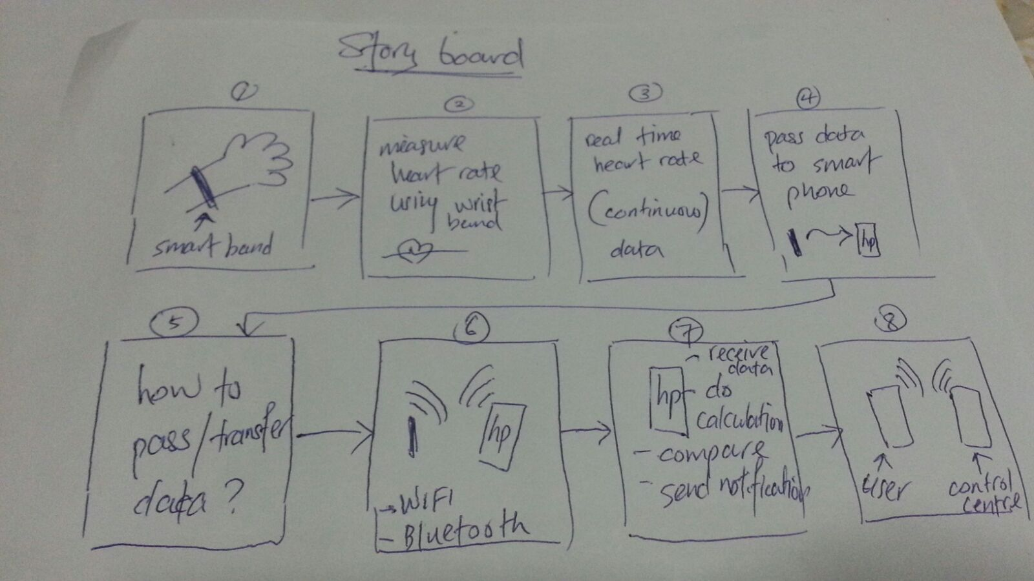
Story Board

Slide 8
Software Development Life Cycle
BIG BANG
model
(don’t restrict to just one method – mix and match)

Slide 9
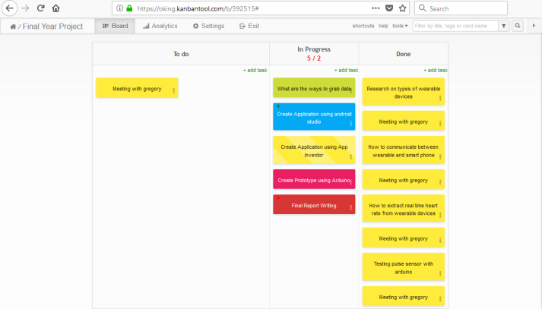
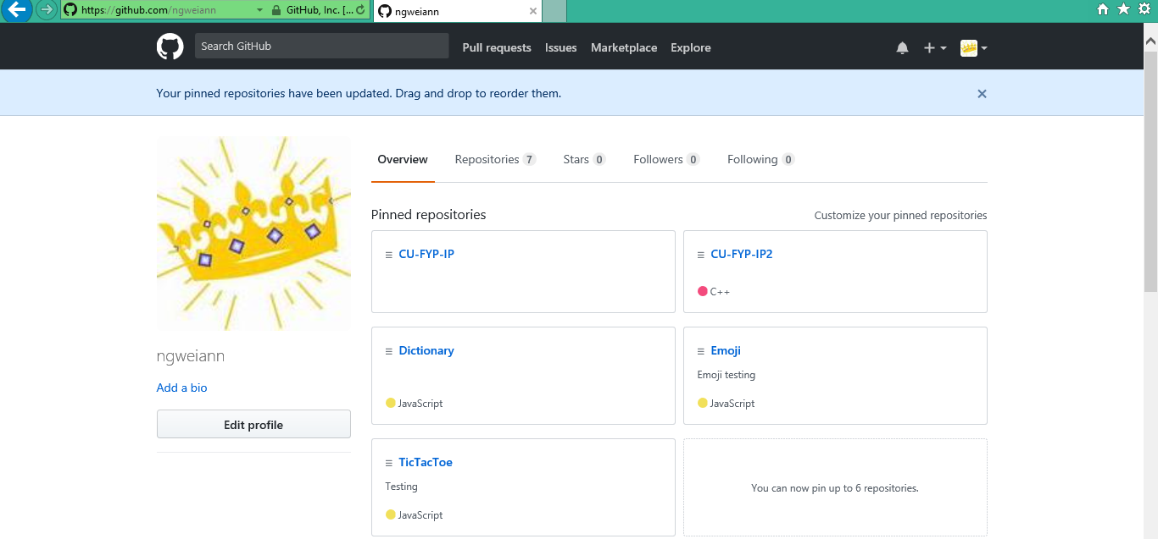
Software project management tool
Github.com
Kanbantool.com

Slide 10
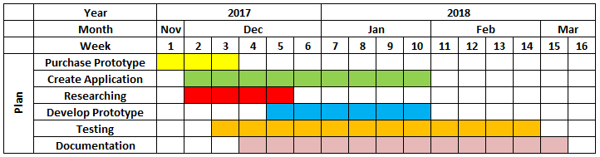
Initial Schedule Planning

Slide 11
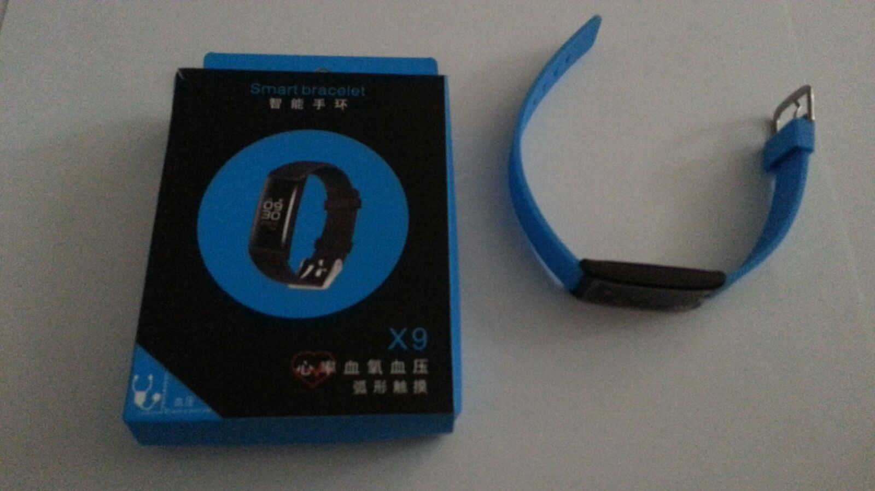
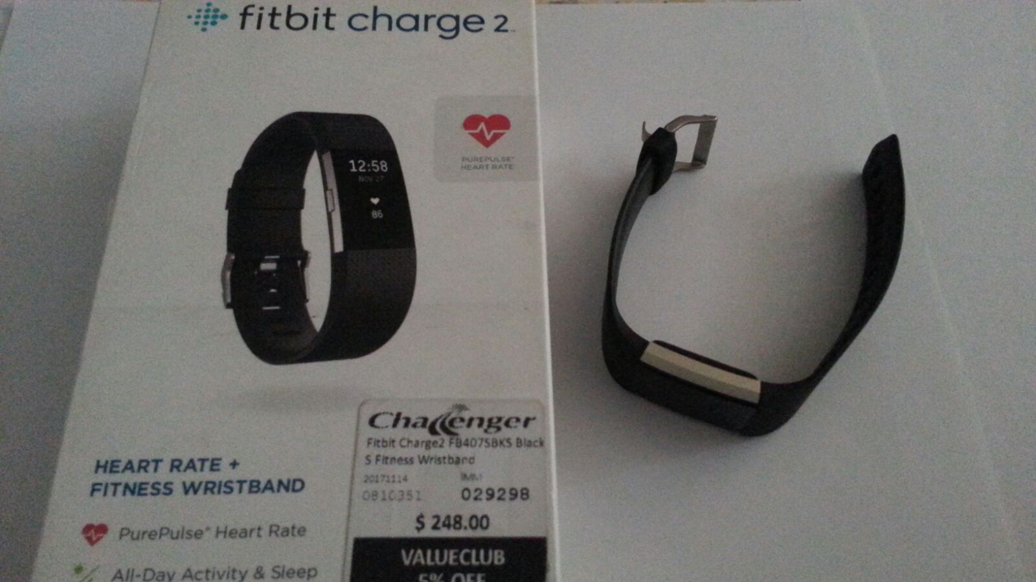
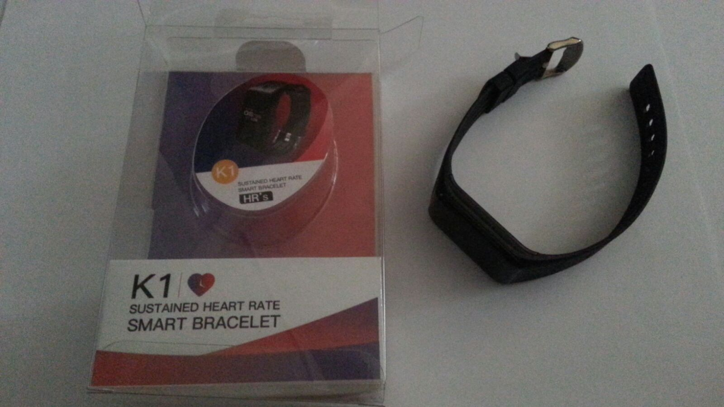
Smart Band

Slide 12
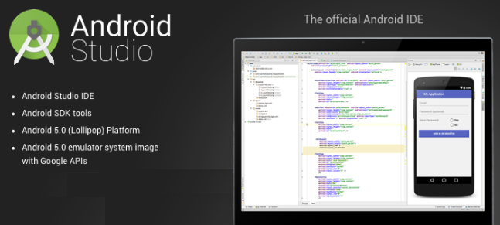
Android Studio Integrated Development Environment (IDE)

Slide 13
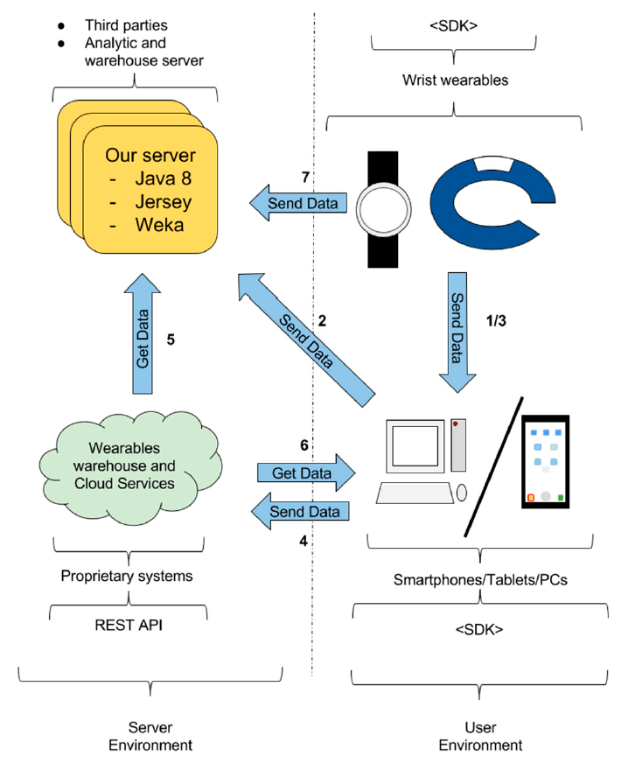
Systems involved in the wearable devices data collection scenario

Slide 14
Data Transfer
Method 01 - Indirect access for Wearable data transfer
Method 02 - Direct access for Wearable data transfer
Method 03 - Indirect access for Warehouse data transfer
Method 04 - Direct access for Warehouse data transfer

Slide 15
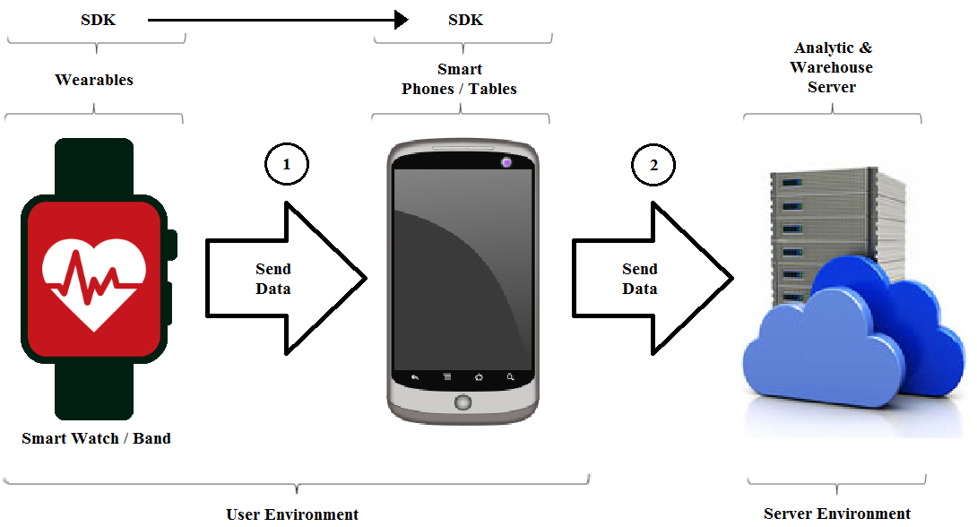
Method 01 - Indirect access for Wearable data transfer

Slide 16
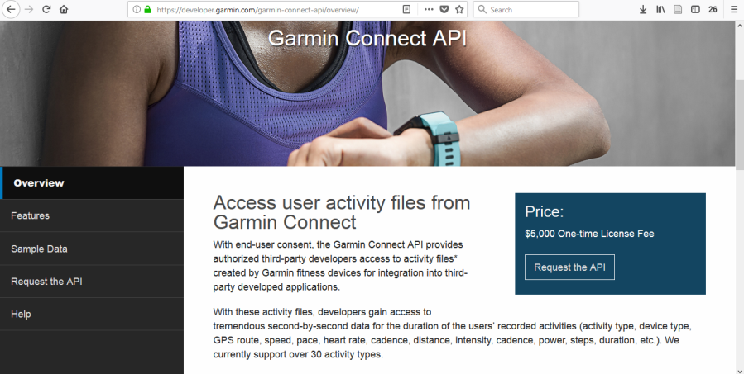
More Obstacles

Slide 17
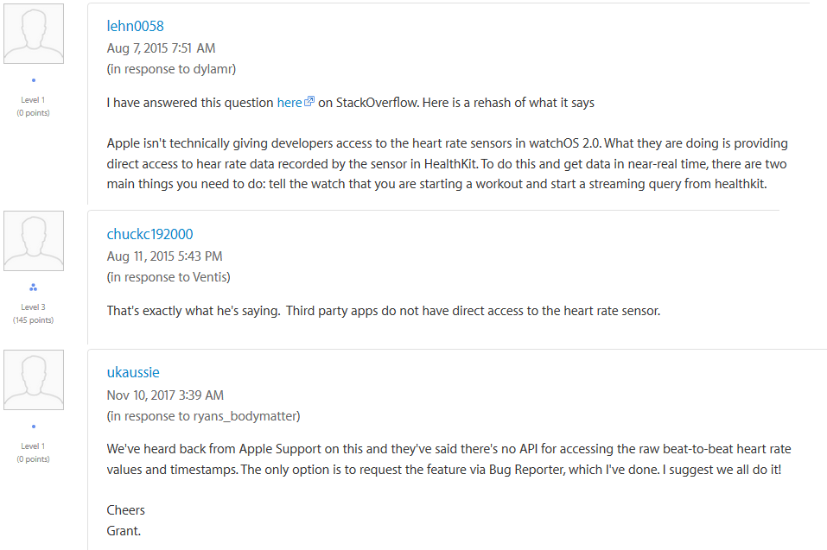
More Obstacles

Slide 18
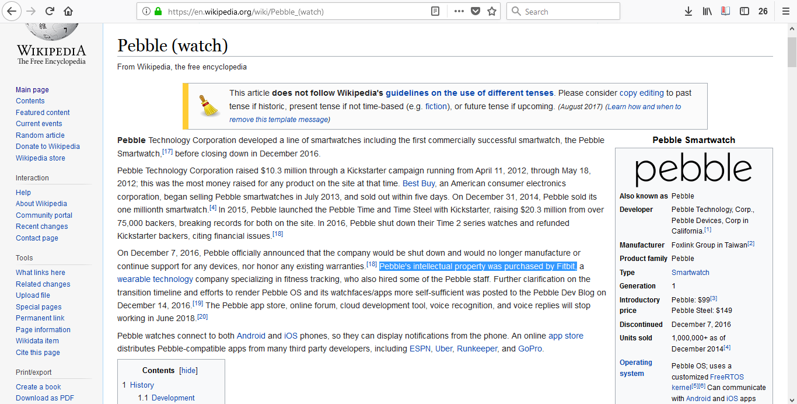
More Obstacles

Slide 19
Abandon Plan
WHY?

Slide 20
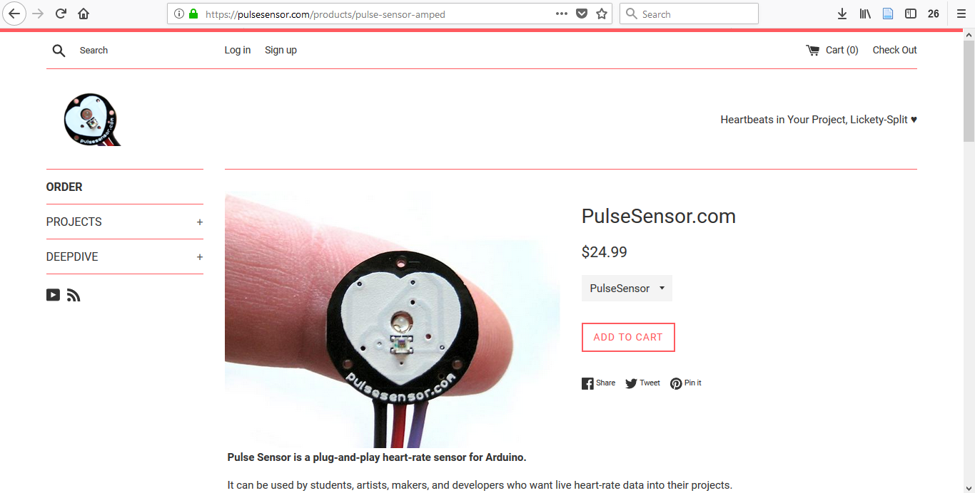
New Direction
Pulse Sensor

Slide 21
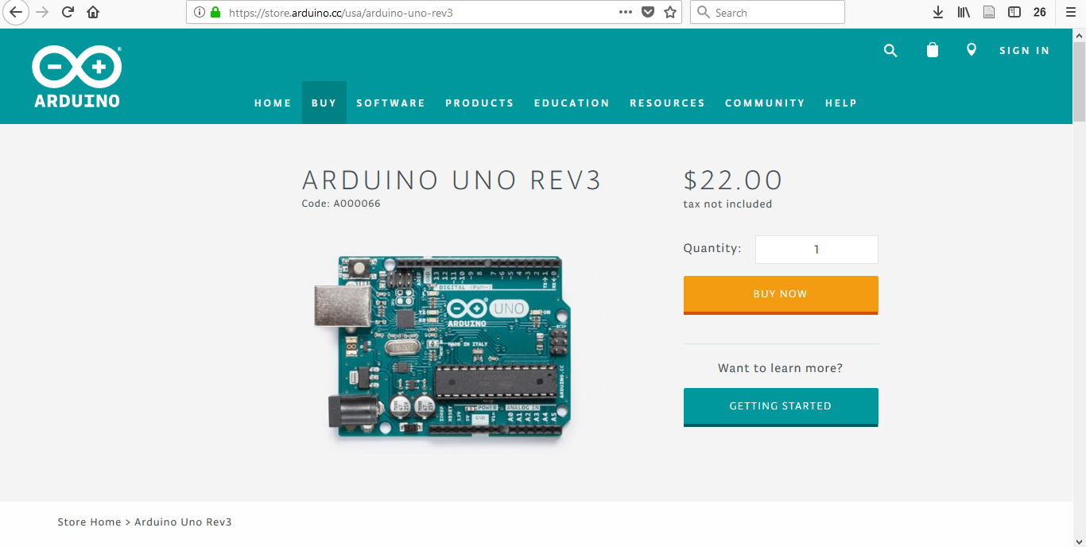
Arduino Board

Slide 22
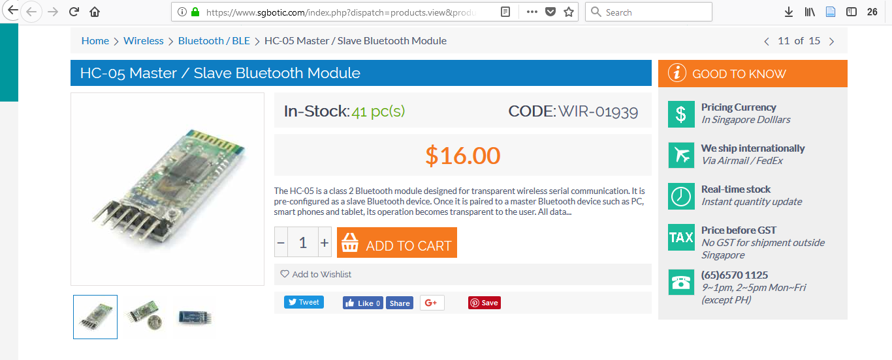
Bluetooth Module

Slide 23
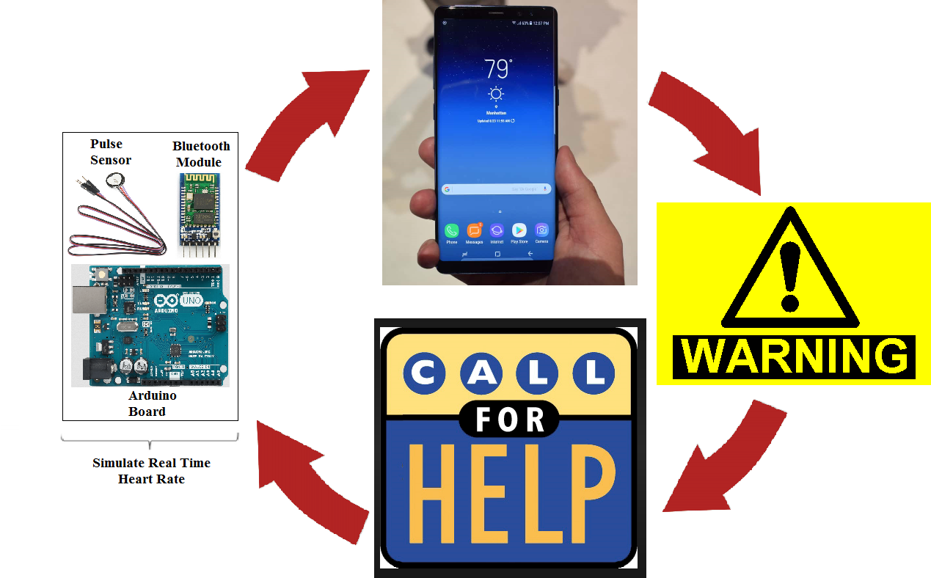
Modifying Previous Idea

Slide 24
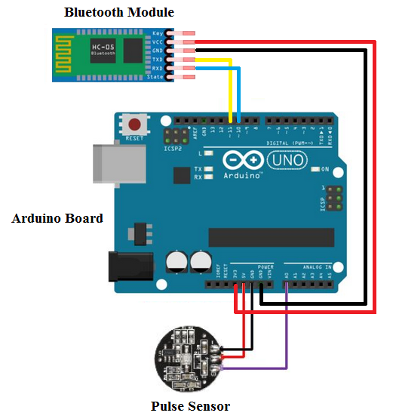
Building prototype

Slide 25
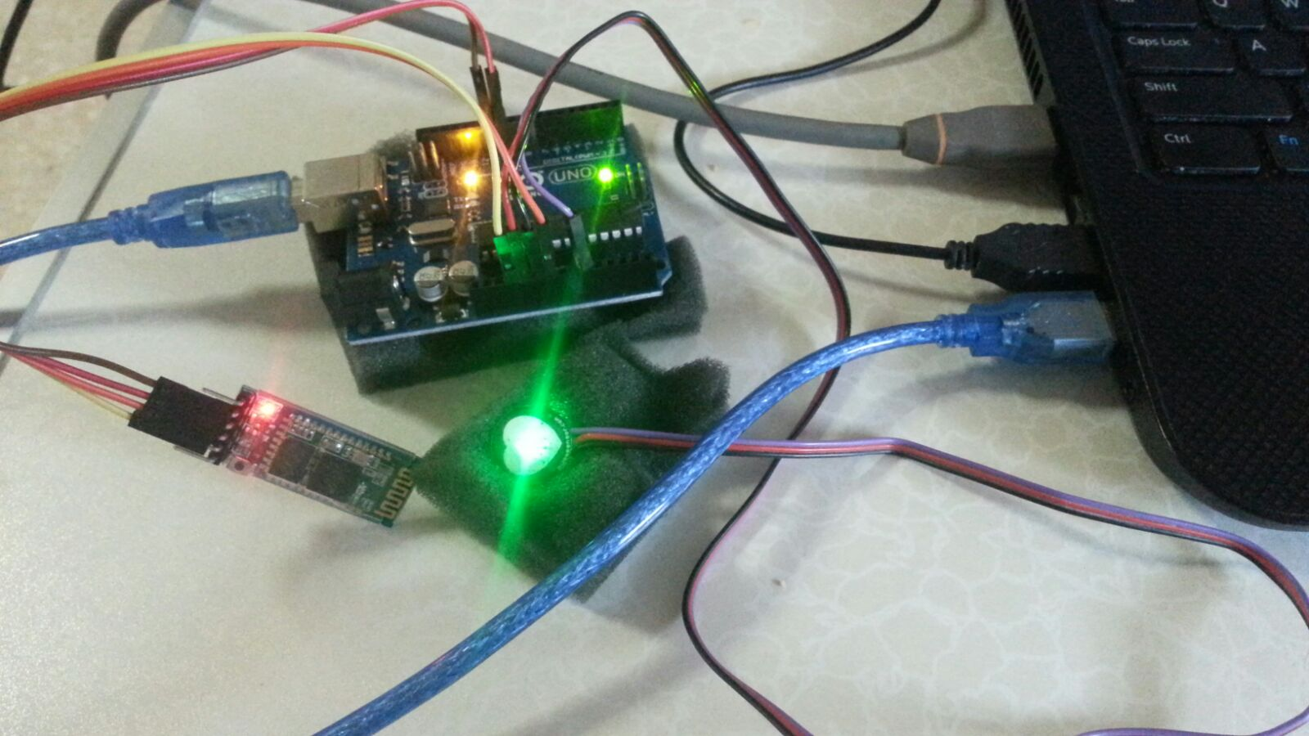
Actual Prototype

Slide 26
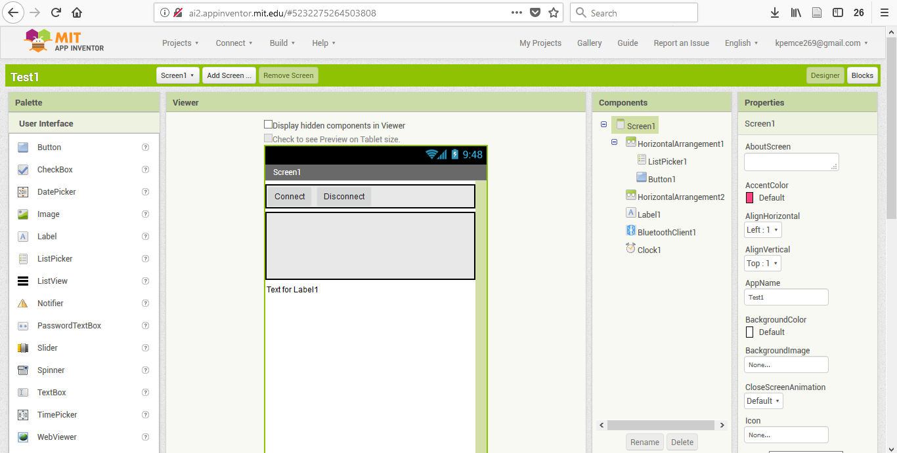
App inventor - Designer

Slide 27
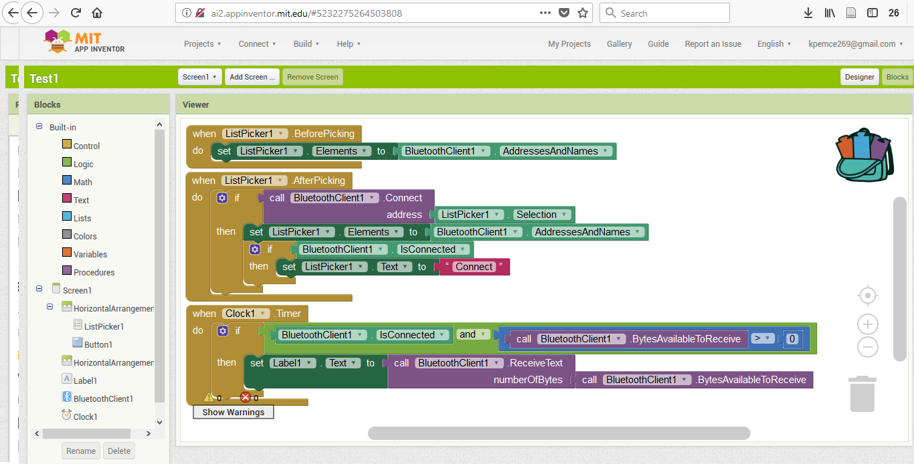
App inventor - Block

Slide 28
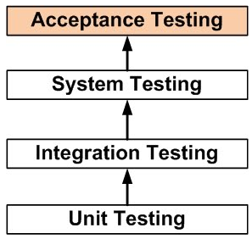
Software Testing

Slide 29
Prototype Demonstration

Slide 30
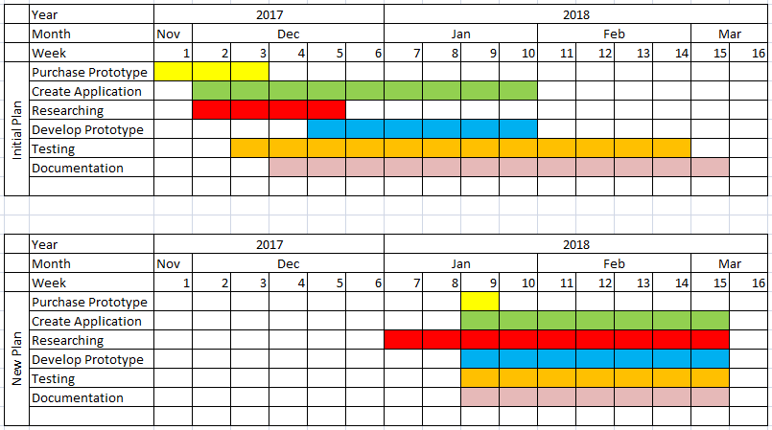
Project Timeline

Slide 31
Future Recommendation
GPS
Short Distance
Text to Speech
Control Centre

Slide 32
Conclusion
Shrink Prototype
Microcontroller

Slide 33
The End

Slide 34
Q & A

